Slide 1


Slide 2

Using web3 to evolve philanthropy
Giveth is the best donation platform in the world!
Our community is focused on Building the Future of Giving using blockchain technology. Our intention is to support and reward the funding of public goods by creating open, transparent and free access to the revolutionary funding opportunities available within the Ethereum ecosystem.
100% of the donations go to the nonprofits and donors are rewarded with GIVbacks.
Provide value for society
Build systems to protect the resources
Build strong incentive systems to protect both the community and individuals
Bring innovation into the public goods space

Slide 3

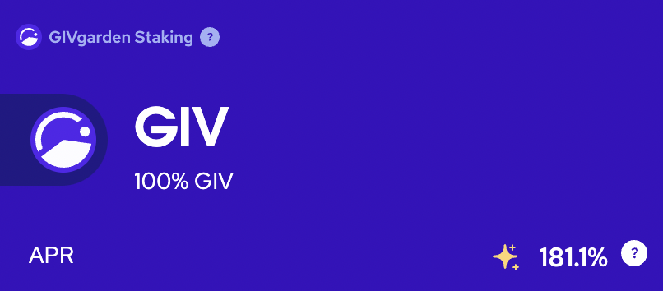
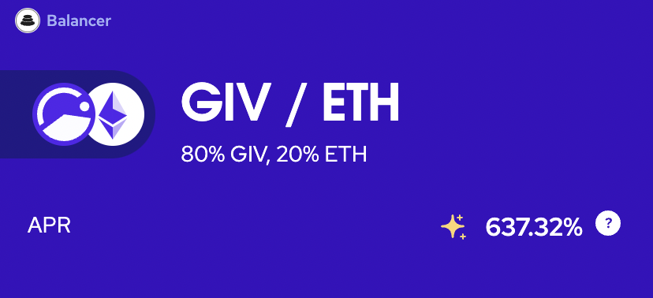
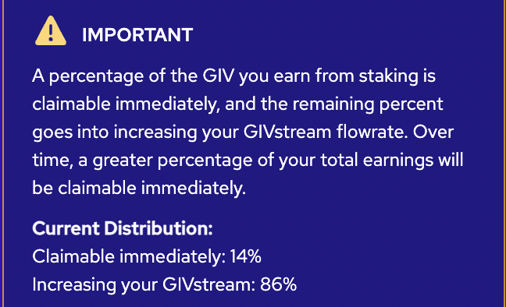
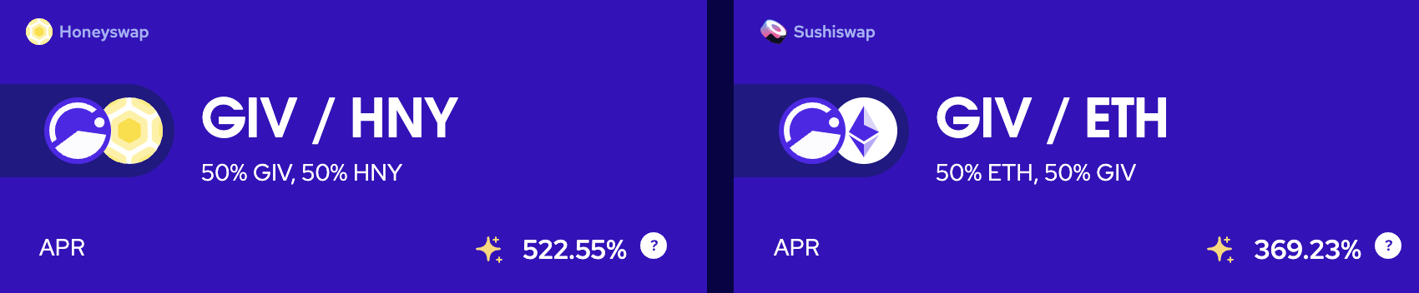
Giveth offers lucrative rewards while attracting and rewarding long-term hodlers
The GIVfarm launched on December 24, 2021. 3.5% of the total token supply, 35 Million GIV, has been allocated to the first GIVfarm round of 6 months, 65 million tokens are held in a multisig for future liquidity provision.
To create more liquidity, we are planning to launch $oneGIV and make a protocol owned Giveth Angel Vault. This way we can protect the value of $GIV for GIVbacks, the GIVgarden & all our future ventures.

Slide 4
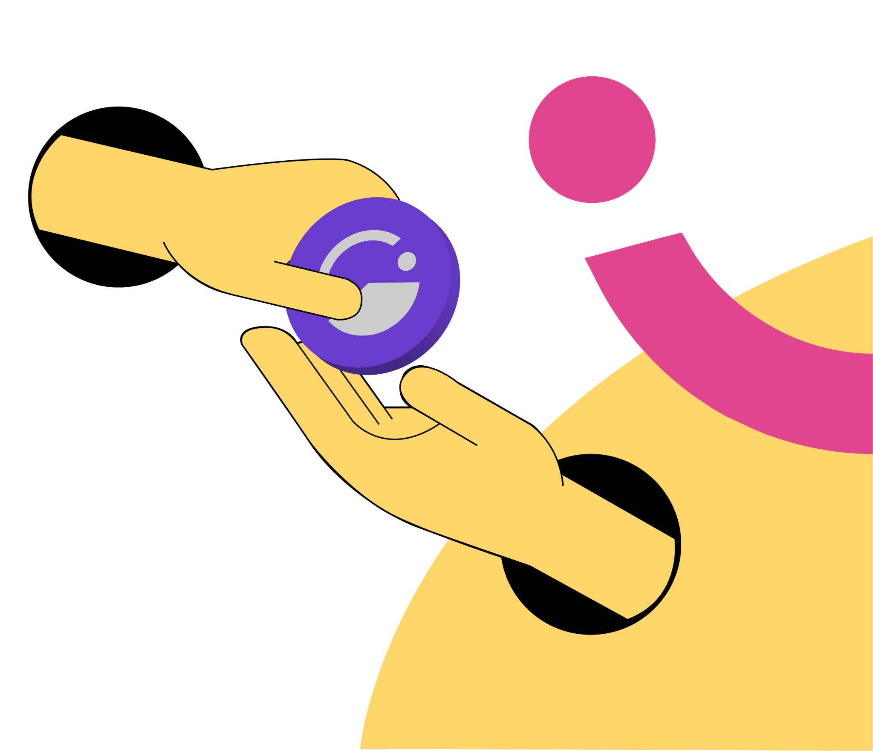
We are selling 1 mil $GIV!
Buy $GIV at a discounted rate and stake it with a higher reward in GIVfarm:
3% discount on $GIV tokens with voting rights > staking in GIVfarm possible - earn rewards
Staking Pools | Chain/Network
80GIV/20ETH Balancer | Mainnet
GIV Staking | Mainnet
GIV/HNY Honeyswap | Gnosis Chain
GIV/WETH Sushiswap | Gnosis Chain
GIVgardens Staking | Gnosis Chain
We will be selling the $GIV tokens prior to launching the Angel Vault (AV).
After launching the AV and building a buy-wall with stable tokens, the GIV price will be stabilized and protected against major downward volatility while improving our APR rates.
 | Now | After Launching ICHI Angel Vault (at $0.40 $GIV)
Total GIV Staked | 6.8mil | 9.3mil
APR | 181% | 132%

Slide 5
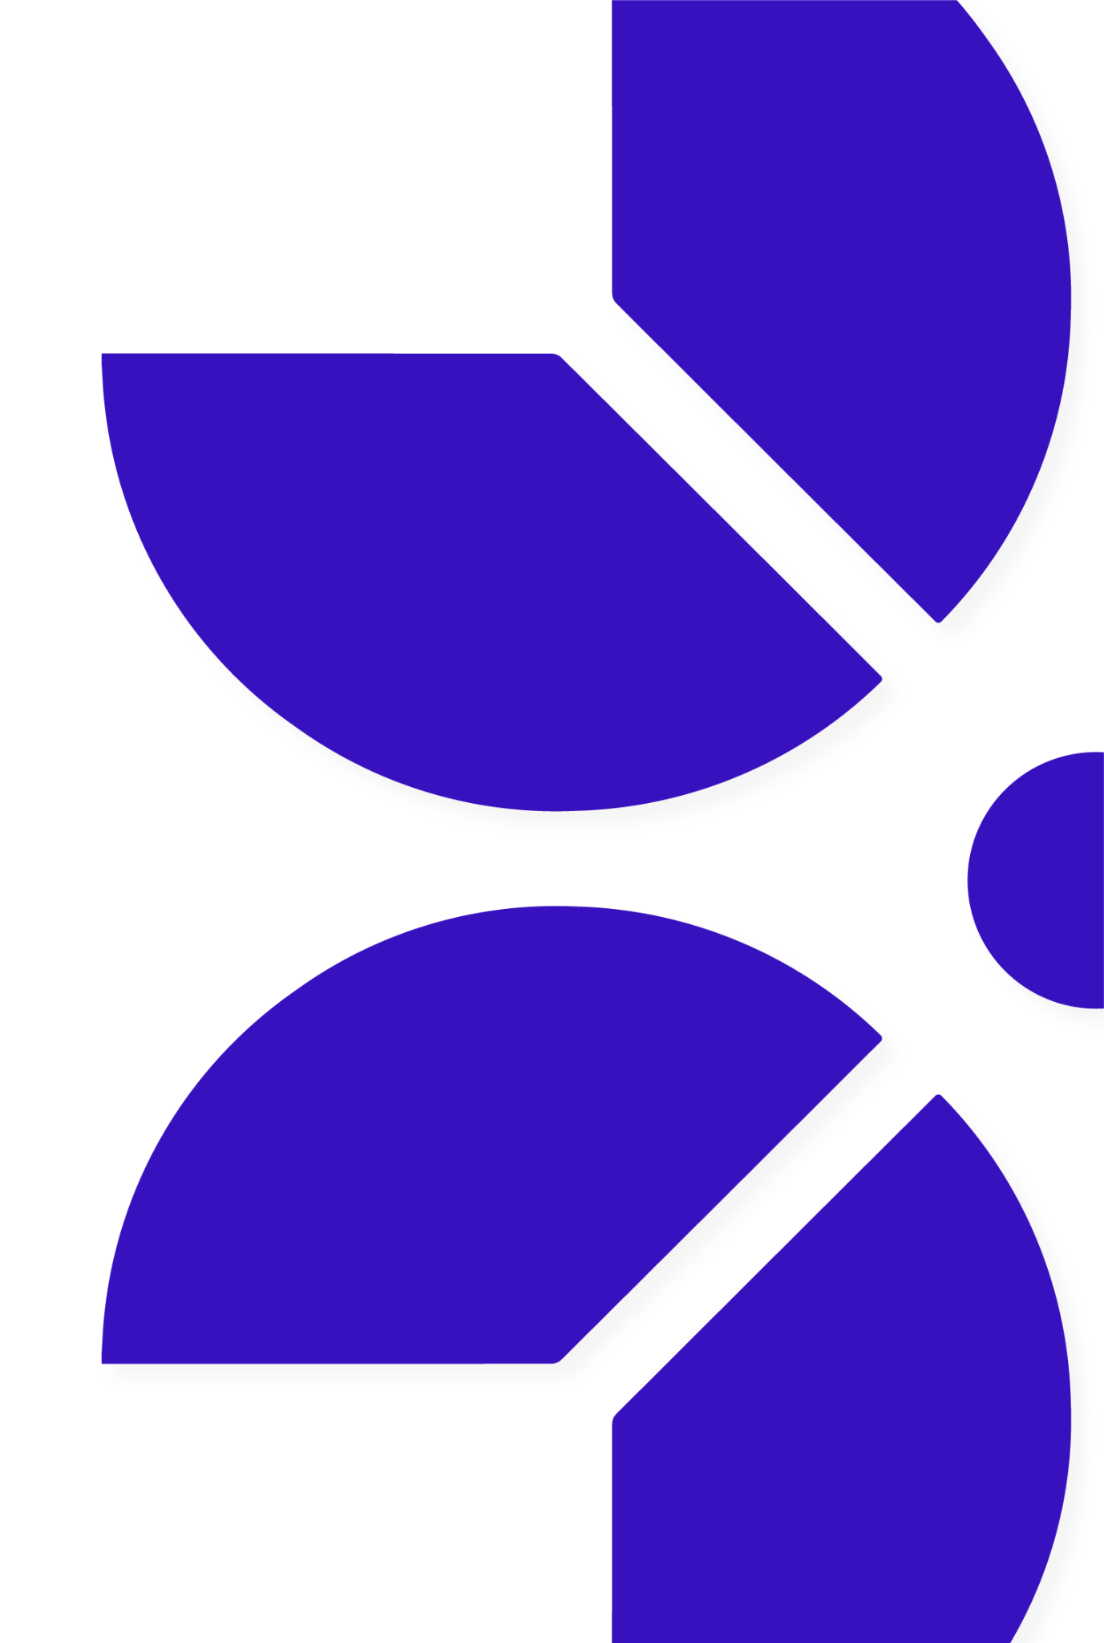
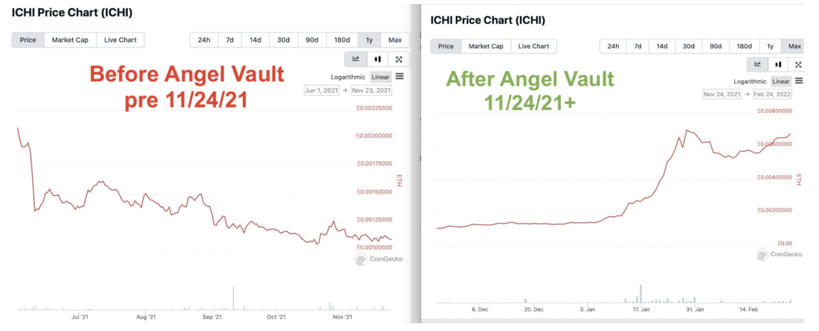
Giveth Angel Vault would create a MASSIVE buy wall on Univ3
Benefits for Giveth: Launching oneGIV stablecoin in the Angel Vault will create a massive buy-wall which supports GIV token price. This will also help with market-wide volatility and cap the impact of market down pressure, but capitalize on the up market. A great example of this practice is ICHI:
Angel Vaults provide protection against price declines while providing high income.

Slide 6
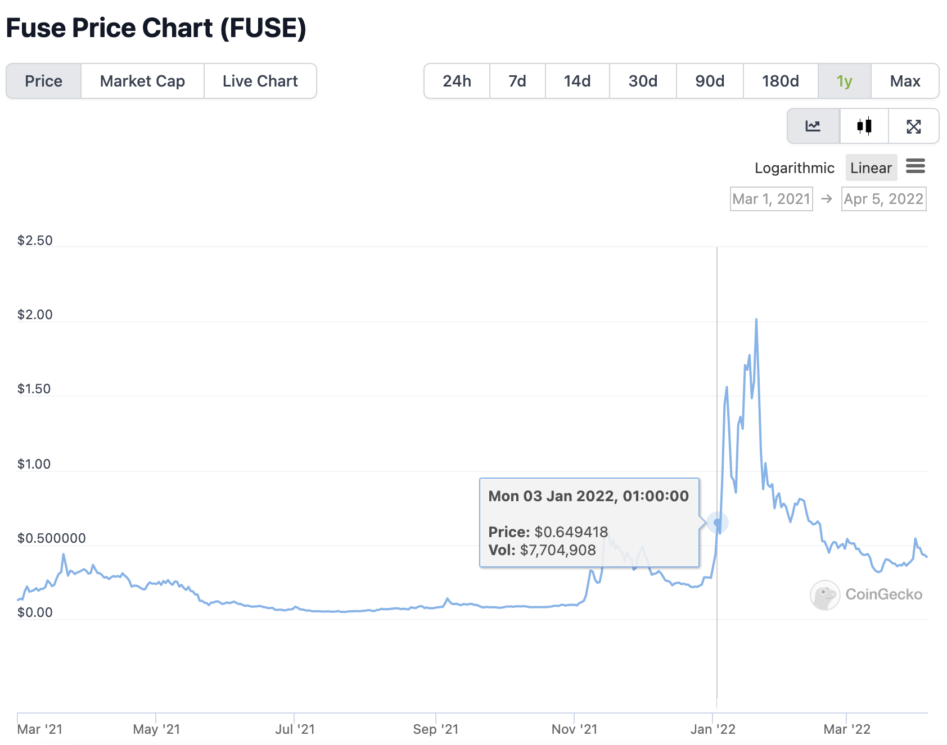
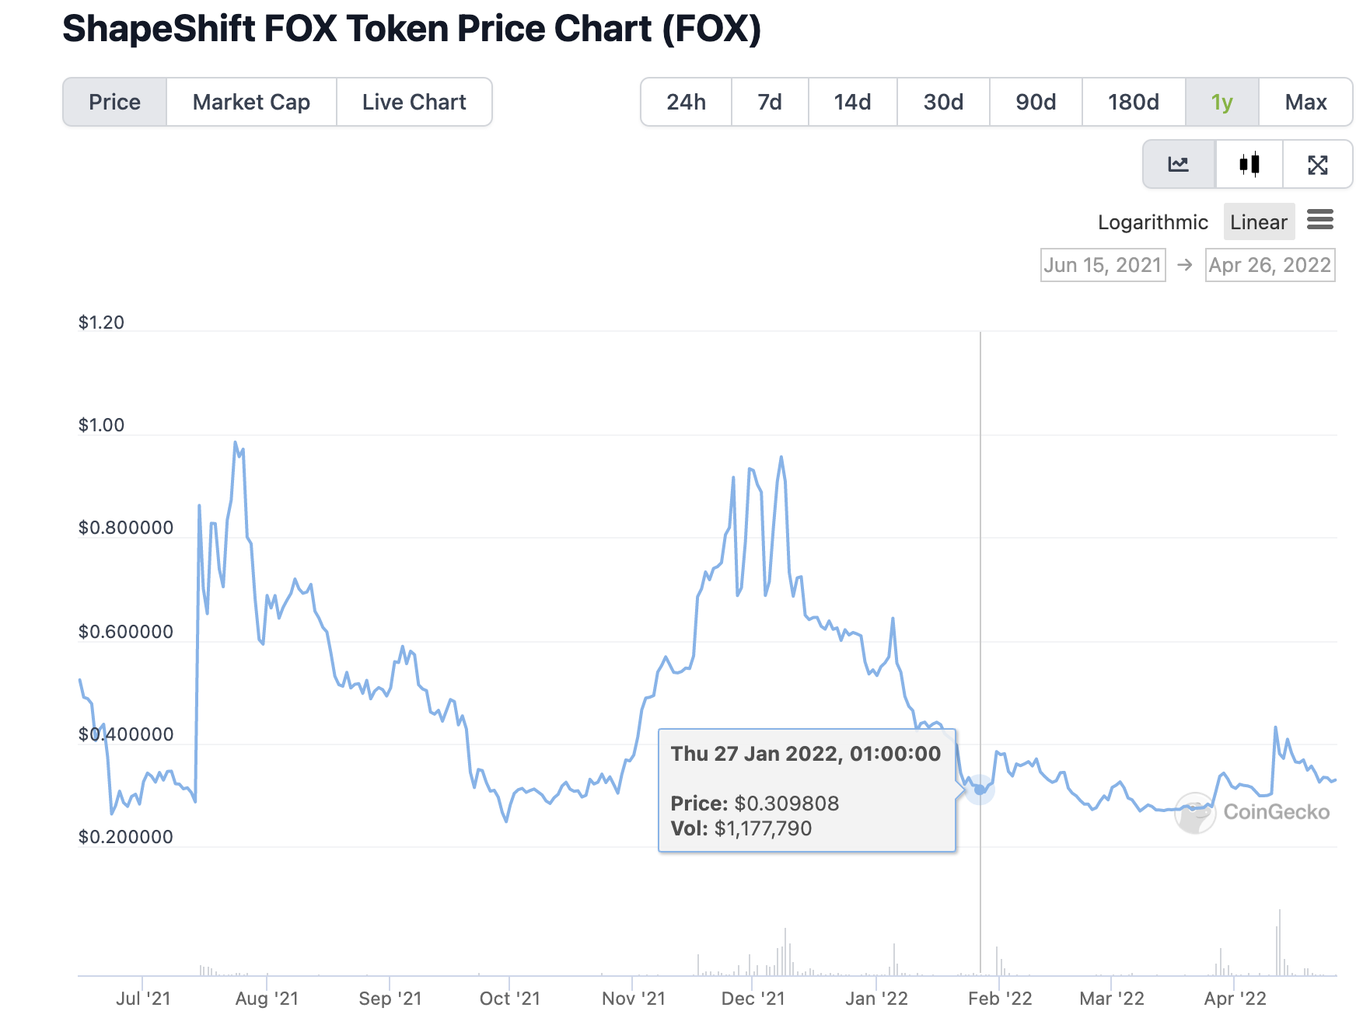
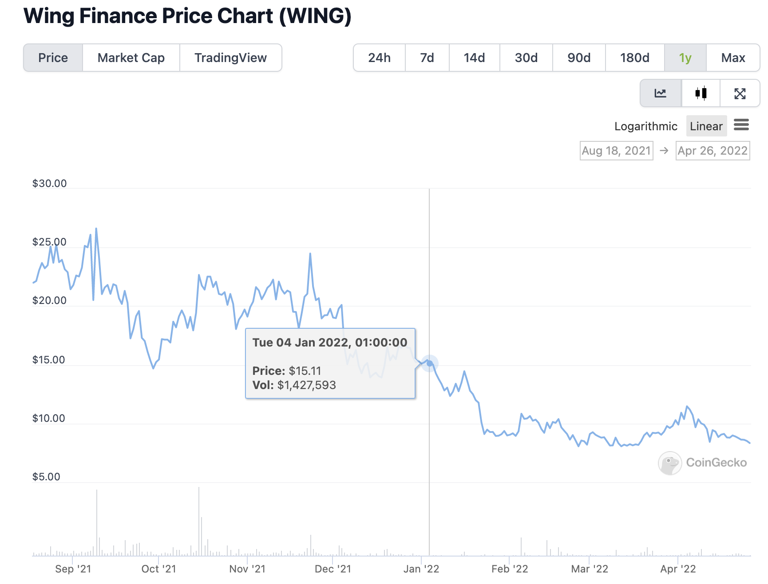
Giveth Angel Vault would create a MASSIVE buy wall on Univ3
Benefits for Giveth: Launching oneGIV stablecoin in the Angel Vault will create a massive buy-wall which supports GIV token price. This will also help with market-wide volatility and cap the impact of market down pressure, but capitalize on the up market. A great example of this practice is ICHI:

Slide 7
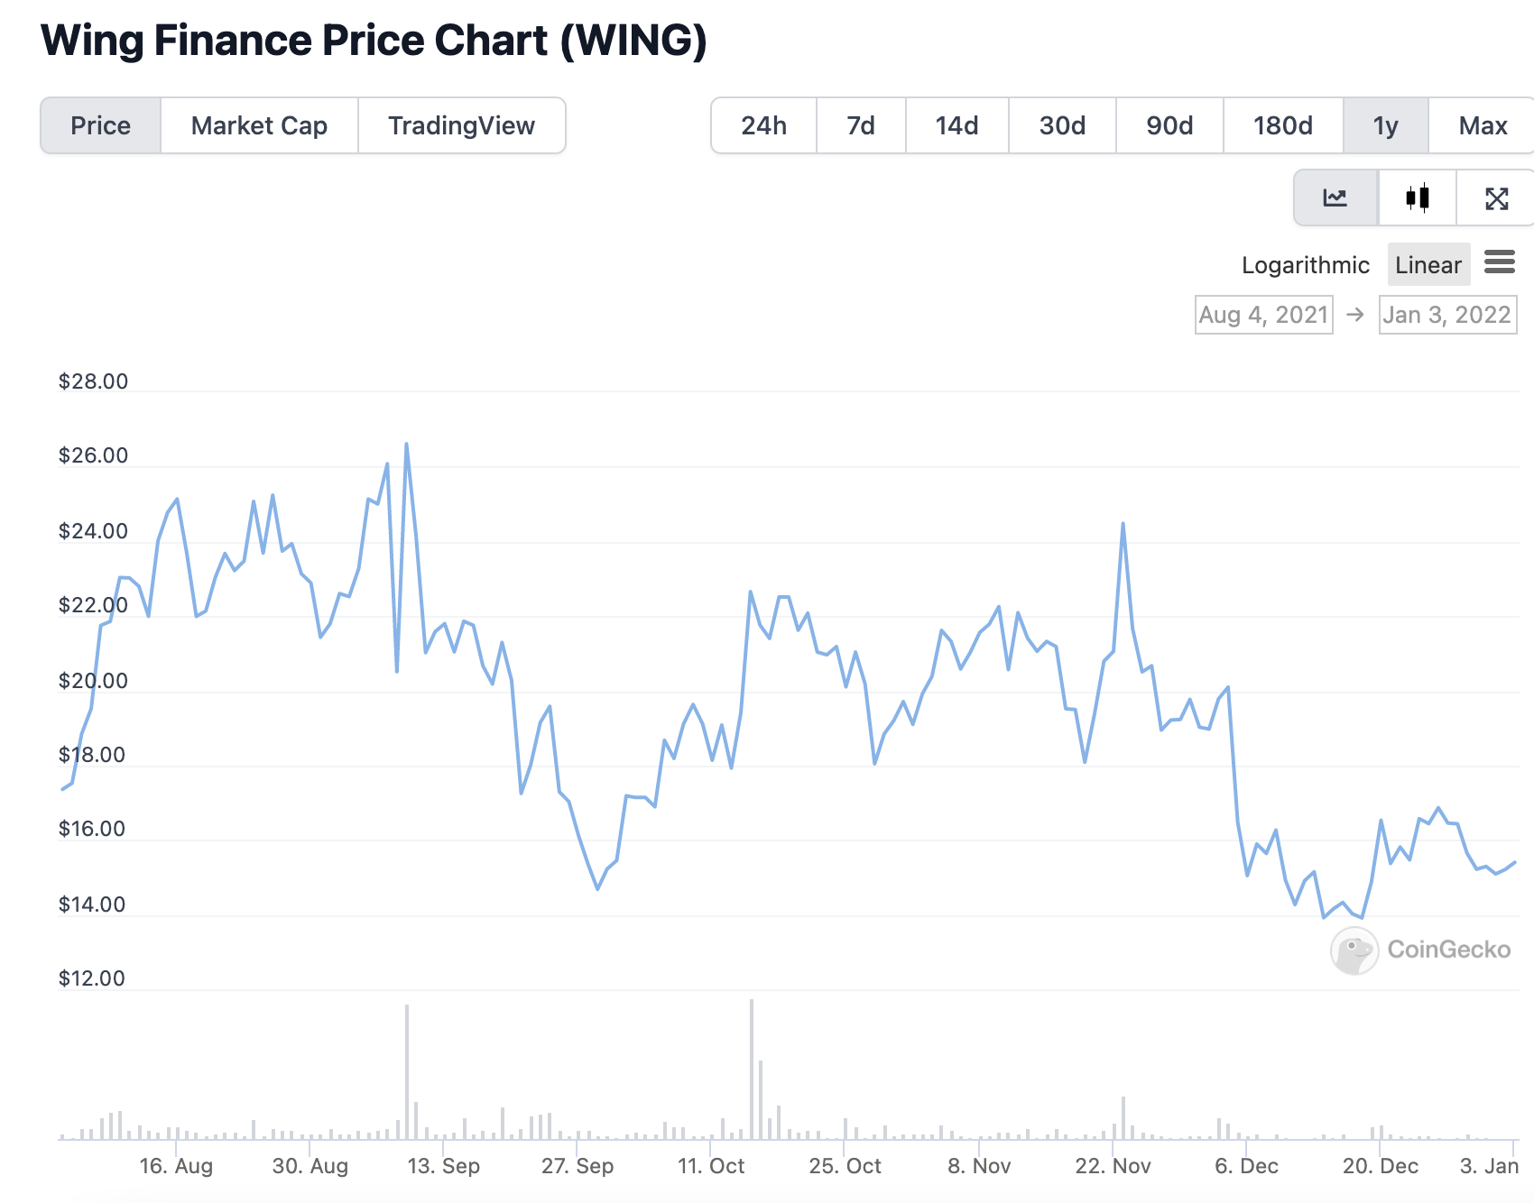
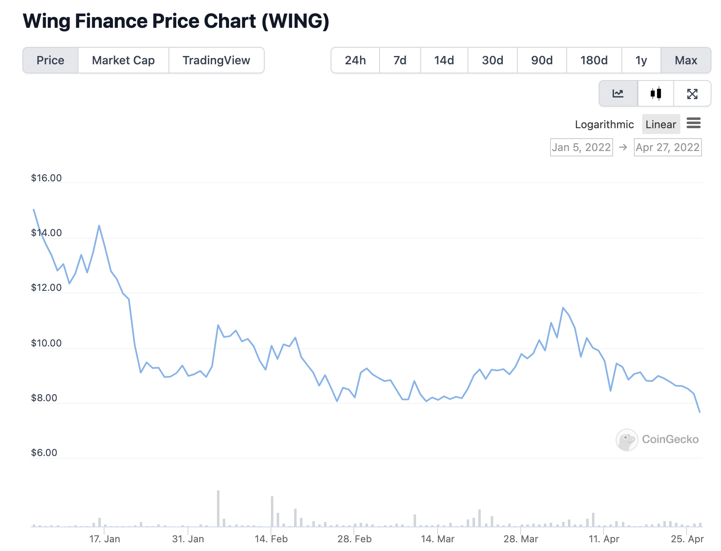
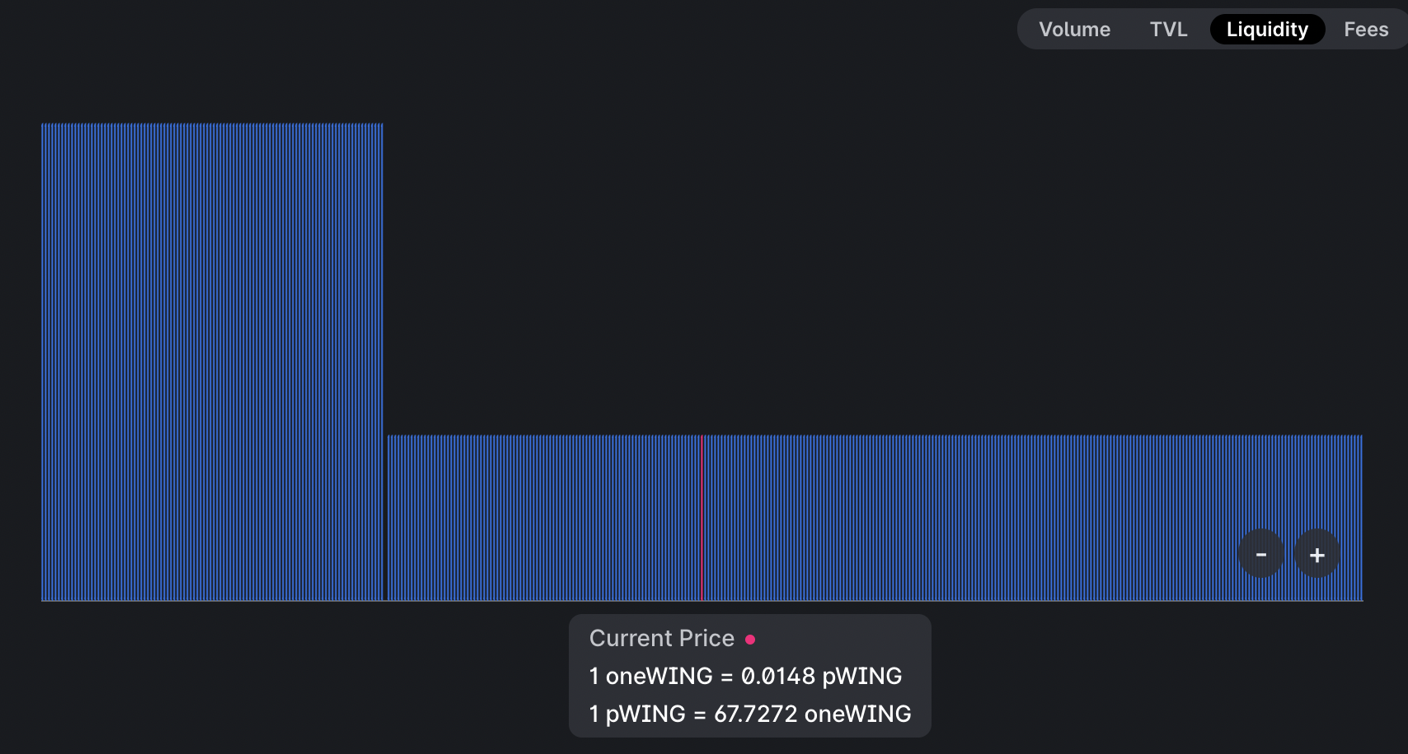
Giveth Angel Vault would create a MASSIVE buy wall on Univ3
Benefits for Giveth: Launching oneGIV stablecoin in the Angel Vault will create a massive buy-wall which supports GIV token price. This will also help with market-wide volatility and cap the impact of market down pressure, but capitalize on the up market. A great example of this practice is ICHI:

Slide 8
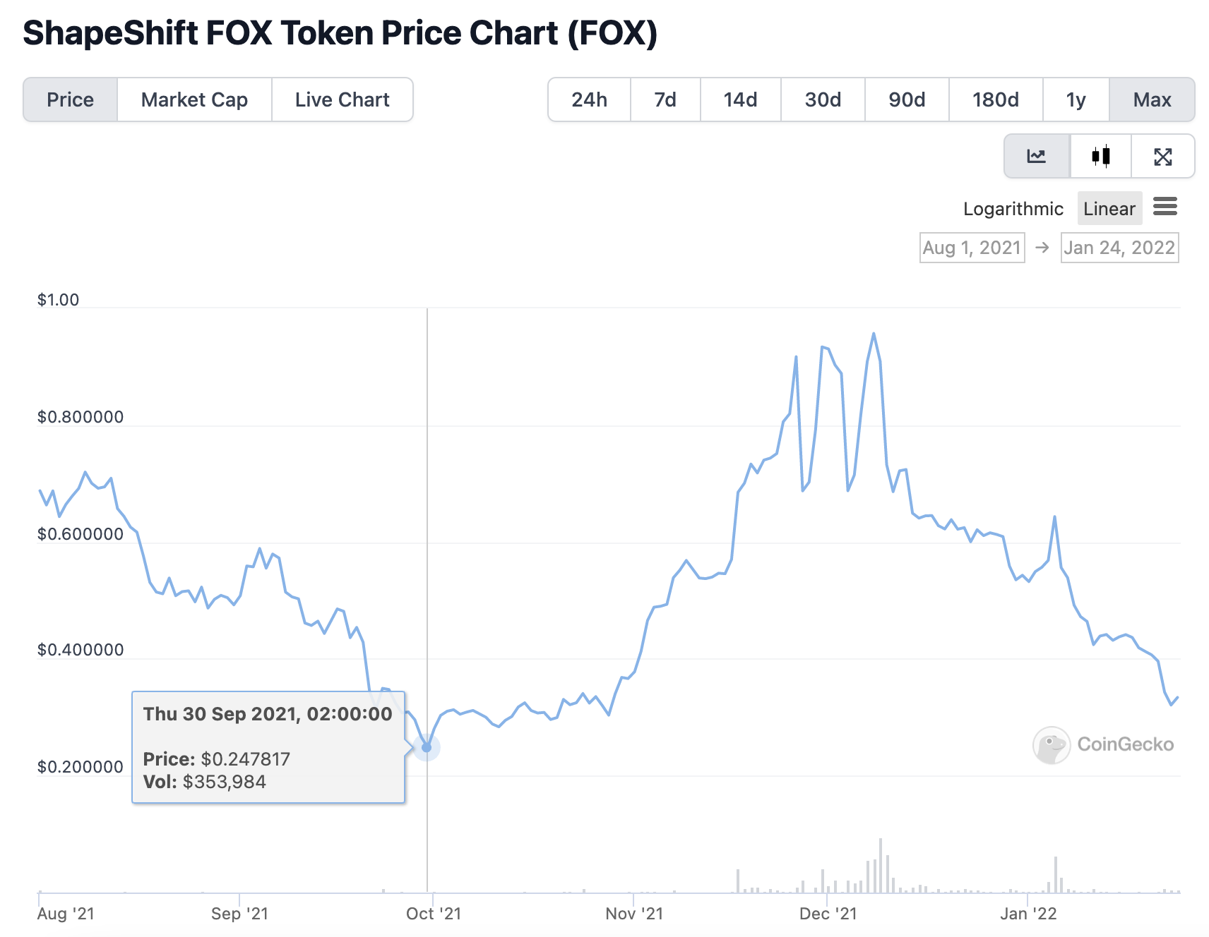
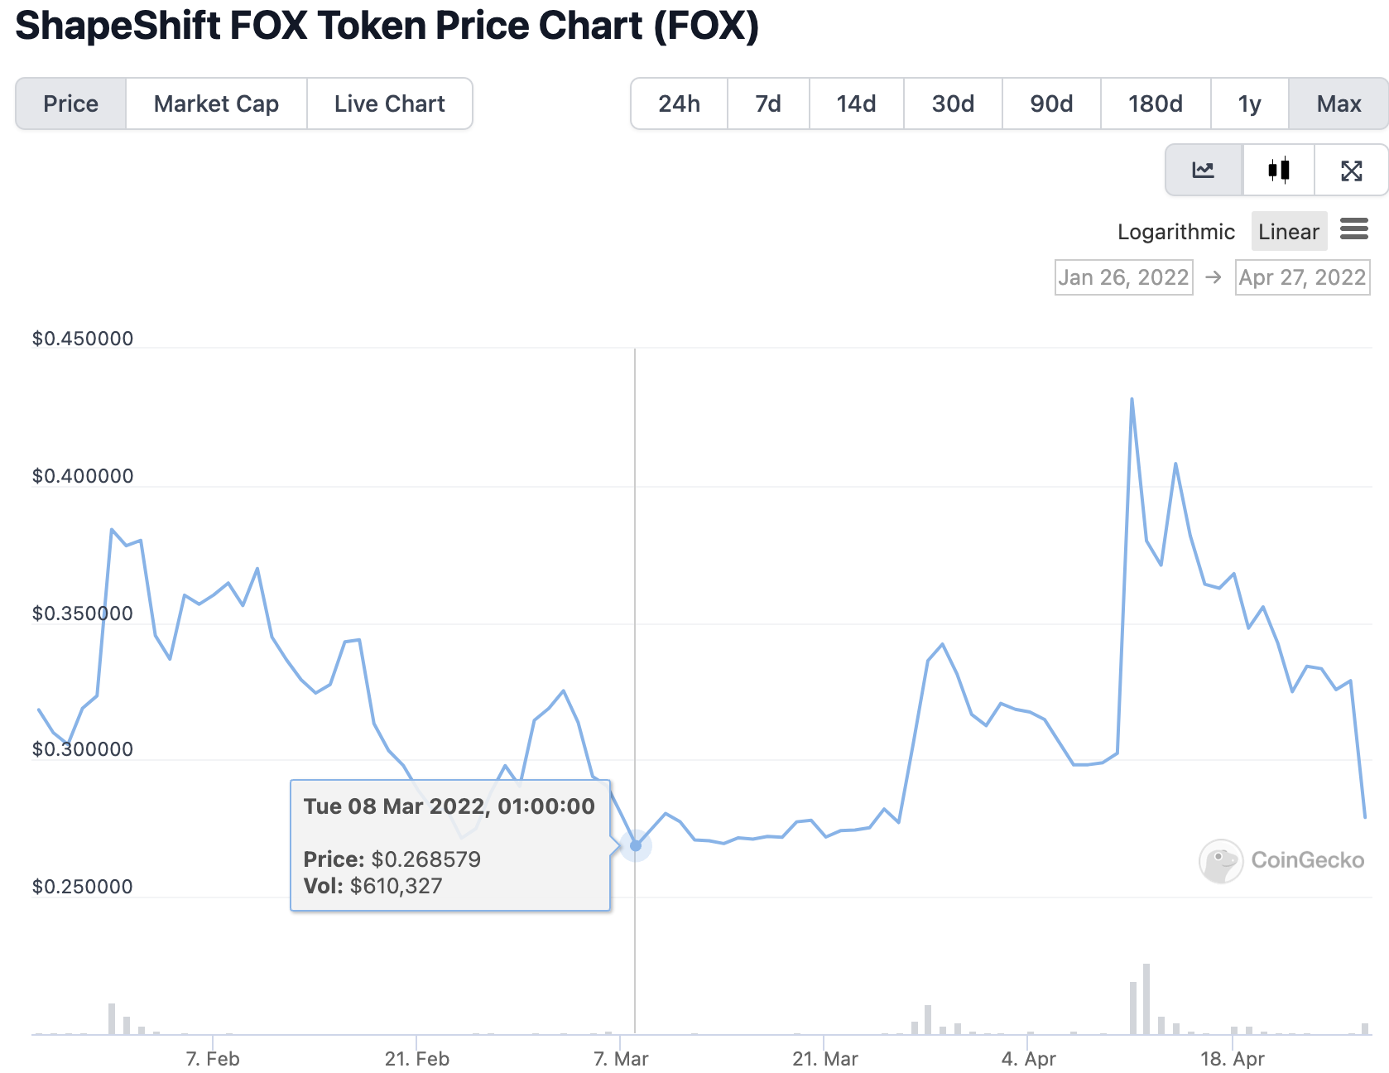
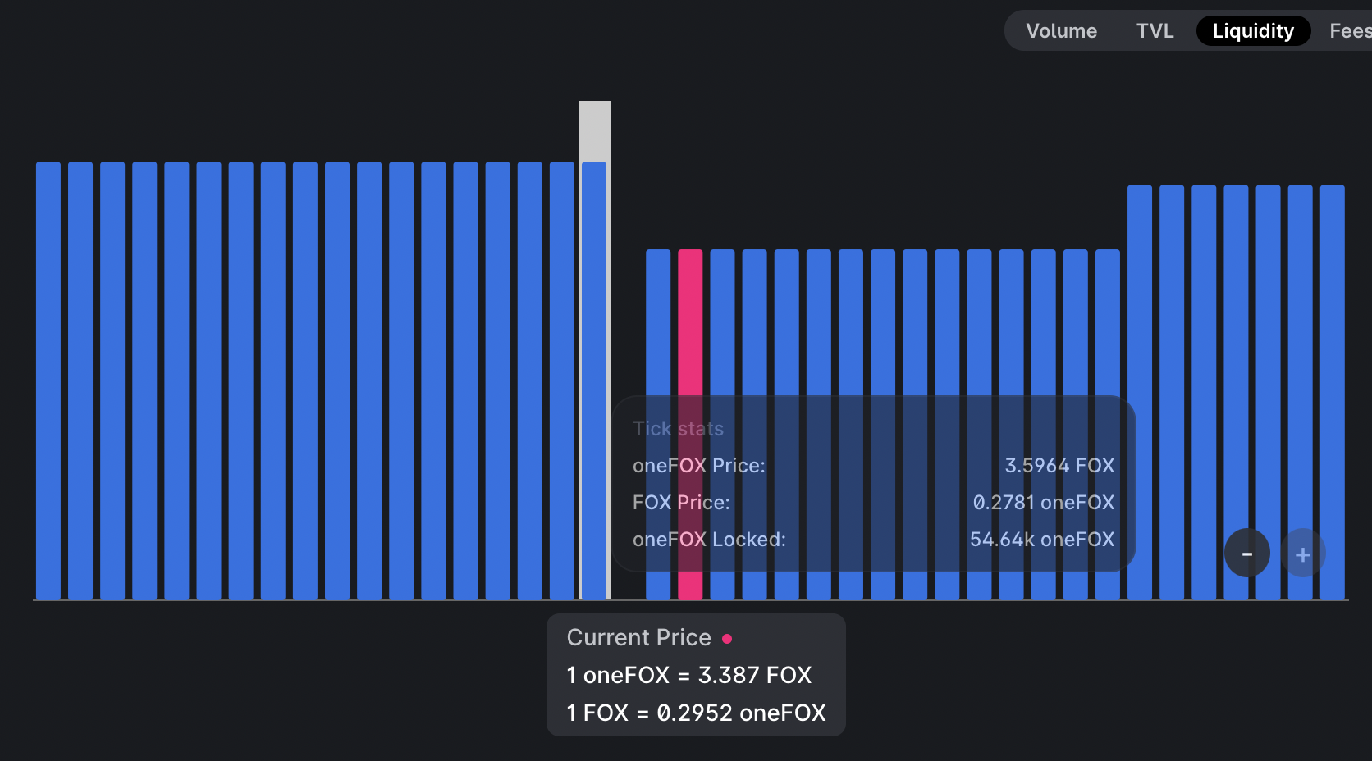
Giveth Angel Vault would create a MASSIVE buy wall on Univ3
Benefits for Giveth: Launching oneGIV stablecoin in the Angel Vault will create a massive buy-wall which supports GIV token price. This will also help with market-wide volatility and cap the impact of market down pressure, but capitalize on the up market. A great example of this practice is ICHI:

Slide 9
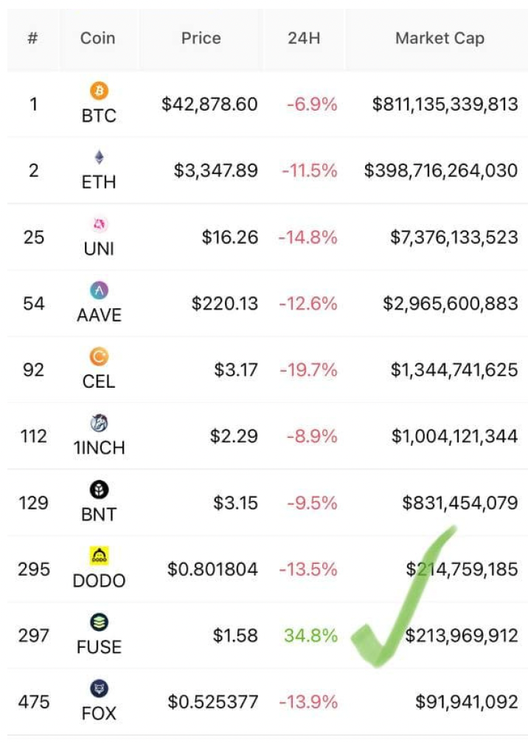
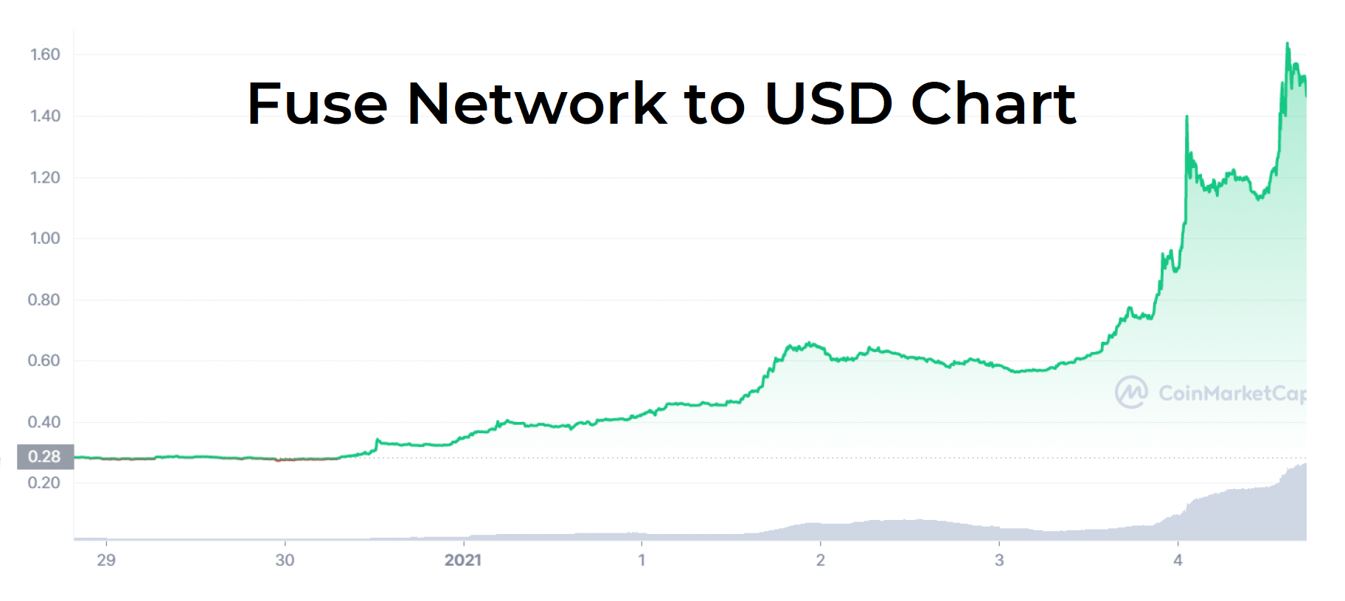
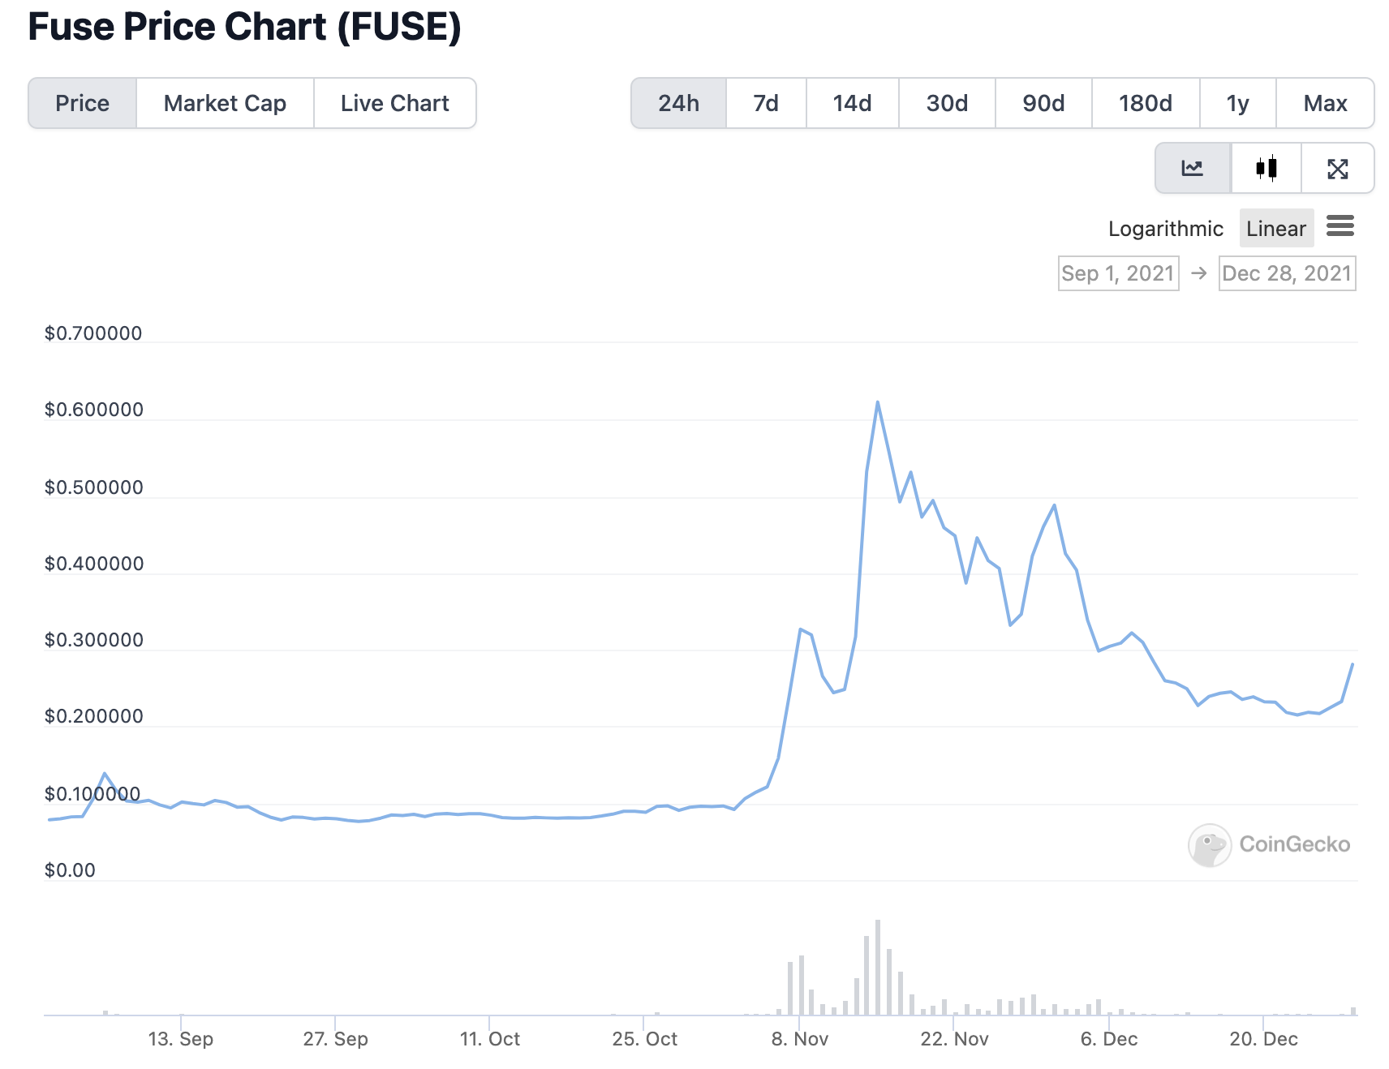
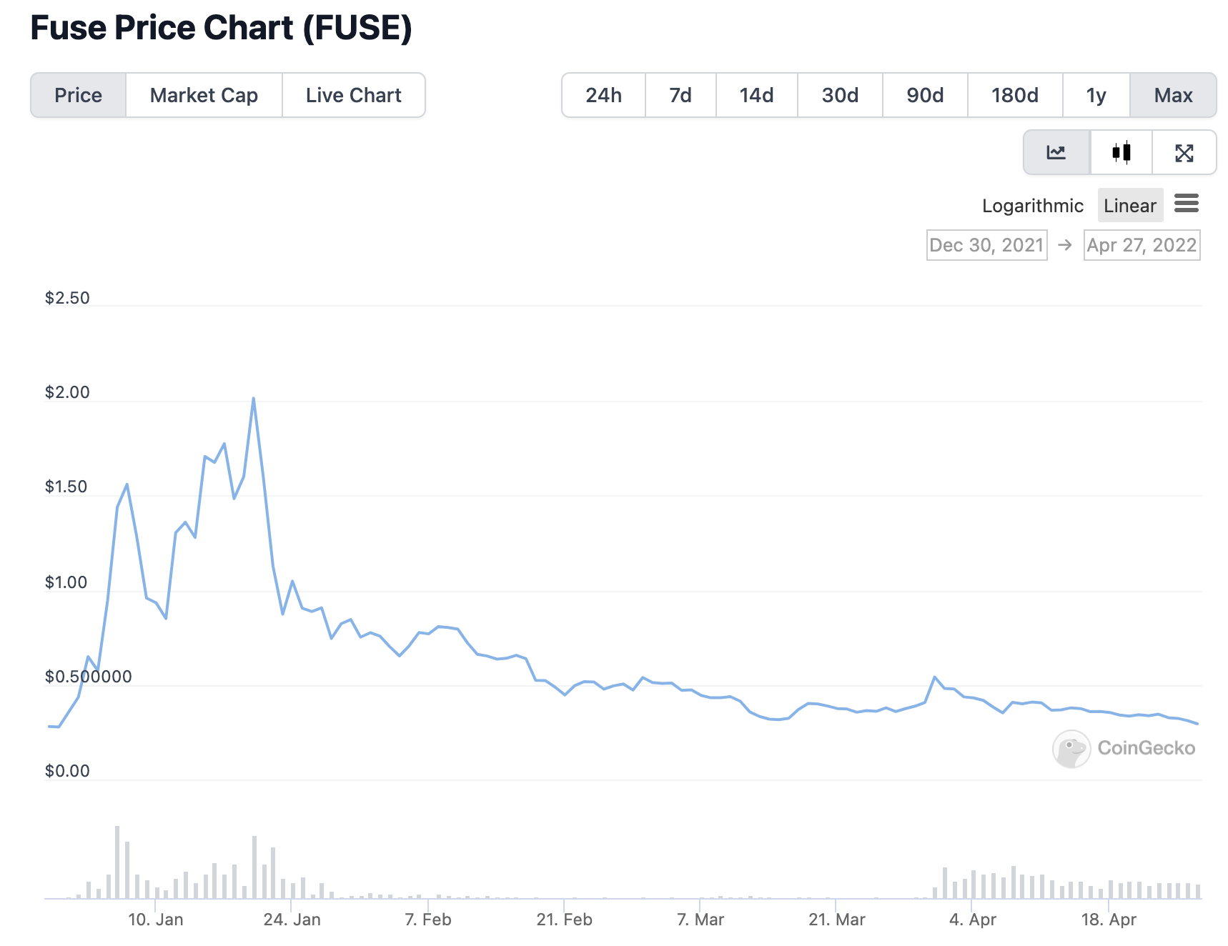
Angel Vault protecting against downward volatility
In the first week after launching FUSE/oneFUSE vault, the price of $FUSE rosefrom $.28 to $1.60. It also provided stability to the prices during a large market crash.

Slide 10
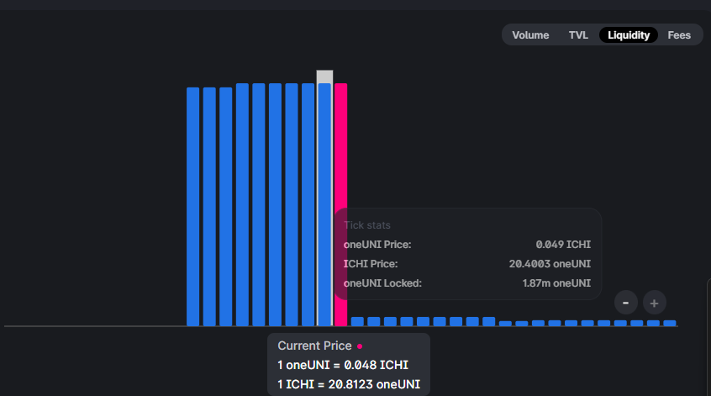
Giveth Angel Vault (example)
An Angel Liquidity Vault is a Uniswap V3 liquidity management tool that allows crypto projects and DeFi users to earn better fees without having to manage their concentrated pool positions.
Example: Pairing stable token with their native token (ICHI-oneUNI case study). Where the red bar represents the spot price of the native crypto asset, and the tall blue bars to the left represent liquidity in the deposit token (stable asset) concentrated underneath the price as buy orders for the crypto asset. At and above the spot price, the Vault will place liquidity in the native asset as sell (take profit) orders. This purchase liquidity is managed by the Angel Vault protocol, protects against price declines, and earns high income. Selling 10% of circulating ICHI only has a -7% price impact

Slide 11
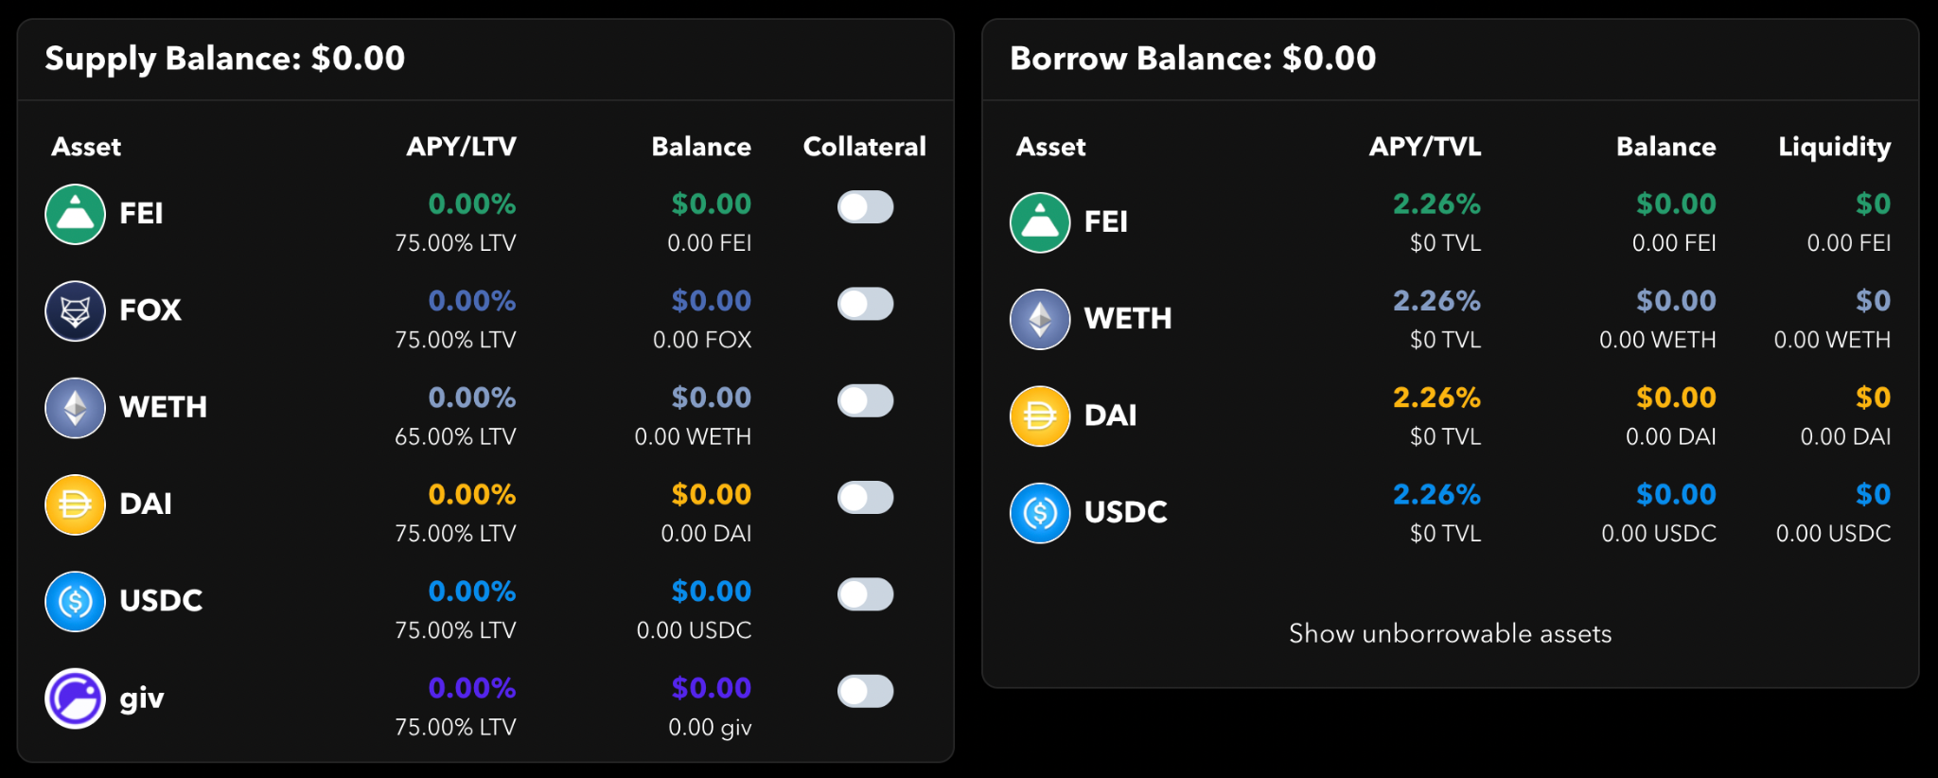
Regen pool on Rari’s Capital Fuse soon LIVE!
We have deployed the Regen Pool which enables the blockchain4good community, especially GIV HODLers to borrow against the community assets - deposit your stable tokens (FEI, Dai) and earn up to EPIC yield in lending fees and $GIV incentives.
We will use GIV tokens to borrow the Stable tokens and use them to fuel our Angel Vault on ICHI which will protect the $GIV price and provide an additional layer of comfort for GIV HODLers who plan to use the asset as collateral when borrowing on Rari Capital.

Slide 12



Join us in Building the
Future of Giving

Slide 14
Using web3 to evolve philanthropy
Giveth is the best donation platform in the world!
Our community is focused on Building the Future of Giving using blockchain technology. Our intention is to support and reward the funding of public goods by creating open, transparent and free access to the revolutionary funding opportunities available within the Ethereum ecosystem.
100% of the donations go to the nonprofits and donors are rewarded with GIVbacks.
Provide value for society
Build systems to protect the resources
Build strong incentive systems to protect both the community and individuals
Bring innovation into the public goods space

Slide 15
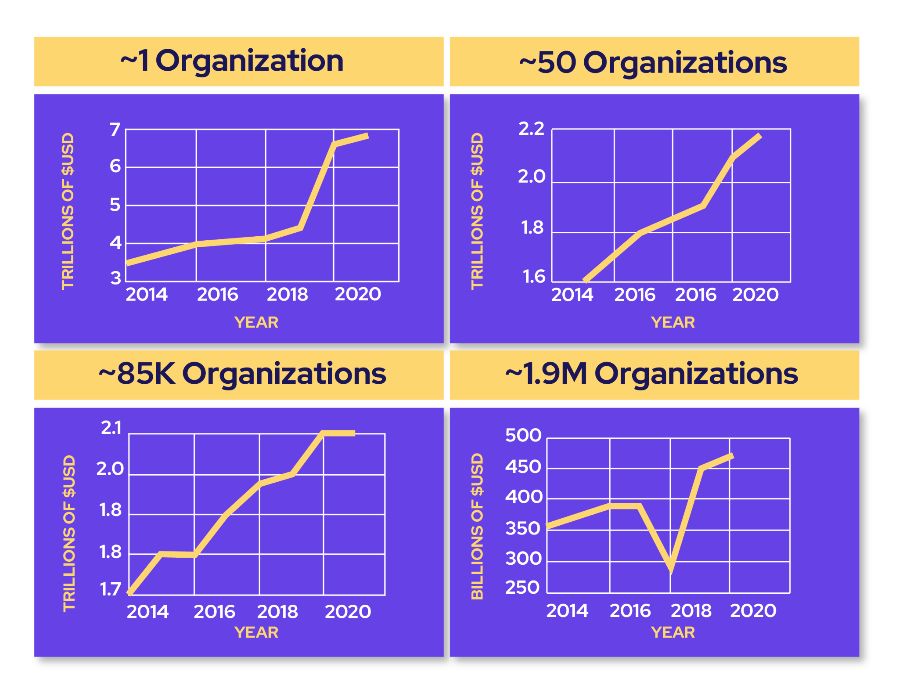
The most overlooked web3 opportunity: Public Goods
We are not often looking at Public Goods as an opportunity.
Federal, state, local governments (in the US alone), and US nonprofits are spending $10.5 TRILLION per annum in this sector.
Over 5x Total crypto market cap
US government donates +500B USD every year through nonprofits but the problem isn’t being solved anytime soon.
We have the opportunity to disrupt this sector in web3.

Slide 16
Regen economies - the solution to government and nonprofits
Mission driven economic systems that reward production and distribution of abundant goods and services to satisfy collective wants and needs.
Provide value for society
Build systems to protect the resources
Build strong incentive systems to protect both the community and individuals
Bring innovation into the public goods space.

Slide 17


GIV is the governance token that fuels and directs the GIVeconomy
We aim to inspire our community to participate in an ecosystem of collective support, abundance and value-creation: GIVeconomy.
Donors to verified projects on Giveth get rewards from GIVbacks.
Liquidity providers and stakers can earn rewards in the GIVfarm.
All GIV holders can create and/or vote on proposals in the GIVgarden.
Anyone who claims GIV from their participation in the GIVeconomy gets a continuous flow of GIV from the GIVstream until December 23, 2026.
Utilizing the GIVstream, all rewards earned in the GIVfarm include some part liquid and some part streaming. This allows the GIVfarm to offer very attractive APRs without creating excessive sell pressure.

Slide 18
Giveth offers lucrative rewards while attracting and rewarding long-term hodlers
The GIVfarm launched on December 24, 2021. 3.5% of the total token supply, 35 Million GIV, has been allocated to the first GIVfarm round of 6 months, 65 million tokens are held in a multisig for future liquidity provision.
To create more liquidity, we are planning to launch $oneGIV and make a protocol owned Giveth Angel Vault. This way we can protect the value of $GIV for GIVbacks, the GIVgarden & all our future ventures.

Slide 19
We are selling 1 mil $GIV!
Buy $GIV at a discounted rate and stake it with a higher reward in GIVfarm:
3% discount on $GIV tokens with voting rights > staking in GIVfarm possible - earn rewards
Staking Pools | Chain/Network
80GIV/20ETH Balancer | Mainnet
GIV Staking | Mainnet
GIV/HNY Honeyswap | Gnosis Chain
GIV/WETH Sushiswap | Gnosis Chain
GIVgardens Staking | Gnosis Chain
We will be selling the $GIV tokens prior to launching the Angel Vault (AV).
After launching the AV and building a buy-wall with stable tokens, the GIV price will be stabilized and protected against major downward volatility while improving our APR rates.
 | Now | After Launching ICHI Angel Vault (at $0.40 $GIV)
Total GIV Staked | 6.8mil | 9.3mil
APR | 181% | 132%

Slide 20
Giveth Angel Vault would create a MASSIVE buy wall on Univ3
Benefits for Giveth: Launching oneGIV stablecoin in the Angel Vault will create a massive buy-wall which supports GIV token price. This will also help with market-wide volatility and cap the impact of market down pressure, but capitalize on the up market. A great example of this practice is ICHI:
Angel Vaults provide protection against price declines while providing high income.

Slide 21
Giveth Angel Vault (example)
An Angel Liquidity Vault is a Uniswap V3 liquidity management tool that allows crypto projects and DeFi users to earn better fees without having to manage their concentrated pool positions.
Example: Pairing stable token with their native token (ICHI-oneUNI case study). Where the red bar represents the spot price of the native crypto asset, and the tall blue bars to the left represent liquidity in the deposit token (stable asset) concentrated underneath the price as buy orders for the crypto asset. At and above the spot price, the Vault will place liquidity in the native asset as sell (take profit) orders. This purchase liquidity is managed by the Angel Vault protocol, protects against price declines, and earns high income. Selling 10% of circulating ICHI only has a -7% price impact

Slide 22
APPENDIX

Slide 23
GIVfarm
xzy

Slide 24
GIVfarm
xzy

